Slide 1
Data Mining, ID2222
Homework 4
Graph spectra
Group 20: Frano Rajic, Ivan Stresec

Slide 2
Implementation
Matlab R2020b
straight-forward implementation
matrix operations
eigen decomposition
k-means
graph class (used for plotting)

Slide 3
Spectral clustering algorithm
create affinity/adjacency matrix A
create Laplacian L = D^{-½} A D^{-½}
D diagonal matrix, D_{ii}= sum_{j}(A_{ij})
create matrix X
stack k largest eigenvectors (determine k by eigengap)
create matrix Y
scale each row of X to be of length 1
use k-means on Y (same k as before)
appoint clusters to nodes according to Y

Slide 4
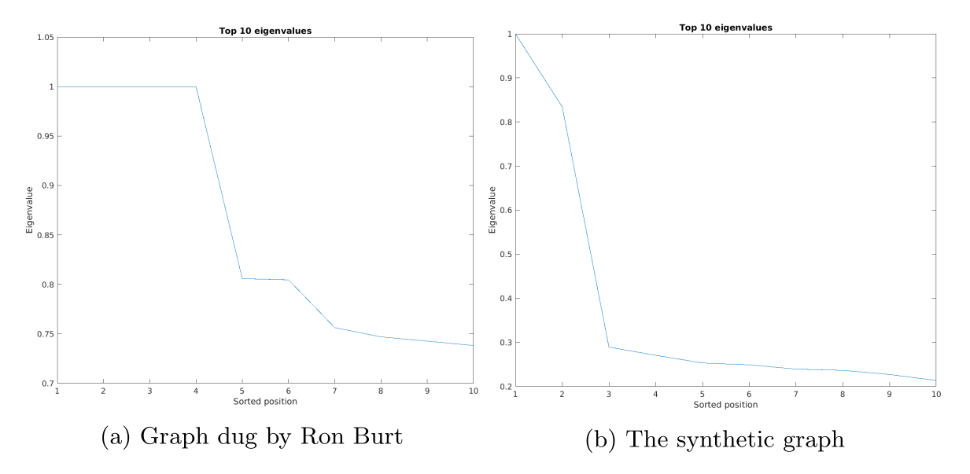
Determining value for k

Slide 5
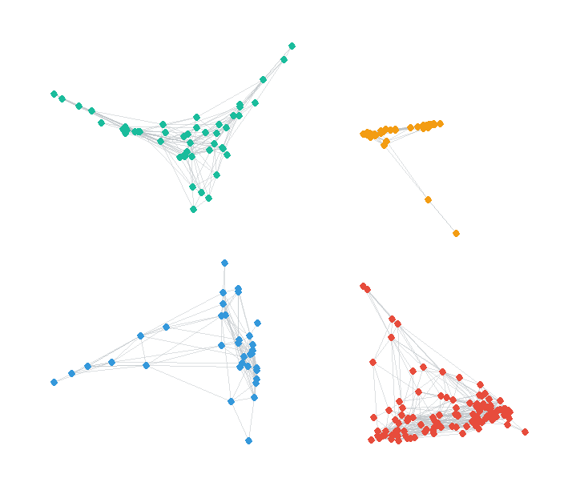
Test results
Example1.dat k = 4
Largest eigenvalues:
1
1
1
1
0.8058
0.8046

Slide 6
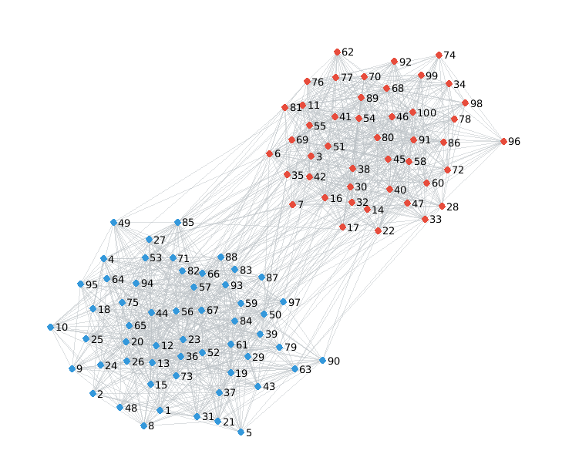
Test results
Example2.dat k = 2
Largest eigenvalues:
1
0.8344
0.2893

